Slide 1
The Legislative Process in Virginia
Wendy Phillips, MS, RD, CNSC, CLE, FAND
VAND Past President

Slide 2
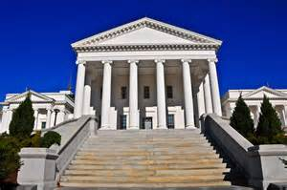
Virginia General Assembly
Bicameral – 2 houses
House of Delegates
100 Delegates
Senate
40 Senators
Odd Years – 45 day session
Even Years – 60 day session
Notes:
Because of the short length of time that they are in session in odd-numbered years, House members are limited to the number of bills that each House legislator can introduce. This means that they have to pick bills very strategically in terms of which of the drafted bills will actually be introduced.

Slide 3
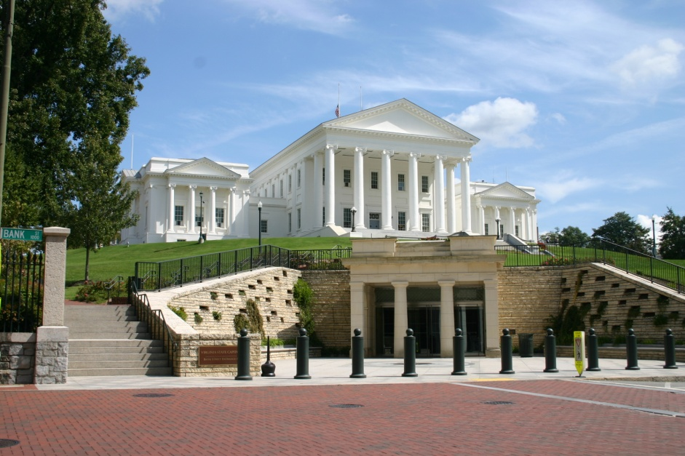
How a Bill Becomes a Law in Virginia
1. An idea for a bill can come from anywhere. This can be for a new law, or to change an existing law, or do away with an existing law
2. Only a Delegate or Senator can actually introduce the law for consideration. This would be the bill’s patron or sponsor
3. Bill is filed with the Clerk and assigned a number. In the House, the Speaker refers the bill to proper committee for discussion and consideration. In the Senate, the Clerk refers bills.
4. The public may provide feedback when the committee is discussing it. Amendments may be made during this time.

Slide 4
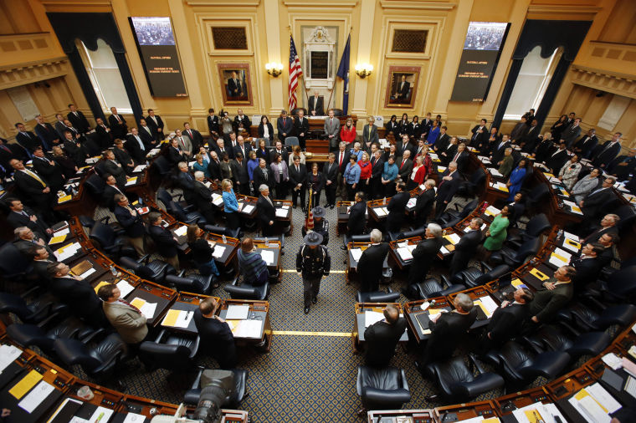
How a Bill Becomes a Law in Virginia
5. If the committee approves it with a vote, it is then sent to the House or Senate for consideration and a vote. The bill must be read 3 times.
First time – bill read by the clerk
Second time – bill may be amended, debated, and enrolled
Third time – Members then vote on final passage
6. If passes one house, goes to the other for a similar process

Slide 5
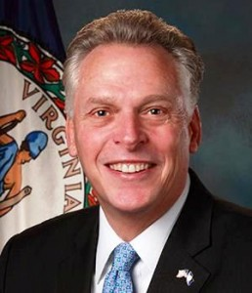
How a Bill Becomes a Law in Virginia
7. If passes both houses, goes to governor who may do 1 of 4 things:
Sign/approve
Veto (in order to override the veto, 2/3 of both houses have to vote to pass the bill notwithstanding the veto)
Returns with changes, which then must be approved by majority vote in both the House and Senate
Ignore it – this rarely happens – bill would still become a law

Slide 6
Priority Focus Areas for the Academy
Consumer and Community Issues
Prevention and treatment of chronic disease, including health care equity
Meeting nutrition needs through the life cycle: Maternal and child nutrition to healthy aging
Quality food and nutrition through education, production, access and delivery
Nutrition monitoring and research

Slide 7
Priority Focus Areas for the Academy
Professional Issues
Licensure: Protection of the Public
Workforce demand: Assuring the Public has access to nutrition services delivered by qualified practitioners
Outcome driven nutrition services in changing health systems

Slide 8
Strategic Plan for VAND
GOAL 3: Advocate for food, nutrition, and health policy. • STRATEGY 1: Provide skills development in the area of advocacy. • STRATEGY 2: Advance individual grassroots actions. • STRATEGY 3: Build targeted relationships to strengthen local and state advocacy efforts. • STRATEGY 4: Achieve licensure of RDs in Virginia. • STRATEGY 5: Support the Academy's federal legislative priority issues.

Slide 9
Steps for Introducing a Licensure Bill
Identify and provide supporting evidence that licensure for RDNs is needed
Find a senator or delegate to be the patron (co-sponsor) for the bill.
Bill is assigned a number
Referred to proper committee
House of Delegates: Health, Welfare, and Institutions
Senate: Education and Health Committee
Public may comment during this period
Amendments may be made during this time
If committee passes it, sent to entire floor for a vote
If passes that house, then goes to the other house for a similar process

Slide 10
VAND Resources
Policy & Advocacy Priorities:
http://eatrightvirginia.org/advocacy/
Public Policy Team
http://eatrightvirginia.org/public-policy-team/
Action Alerts
http://eatrightvirginia.org/advocacy/action-alert/
Contact Us: vand.publicpolicy@gmail.com

